Slide 1

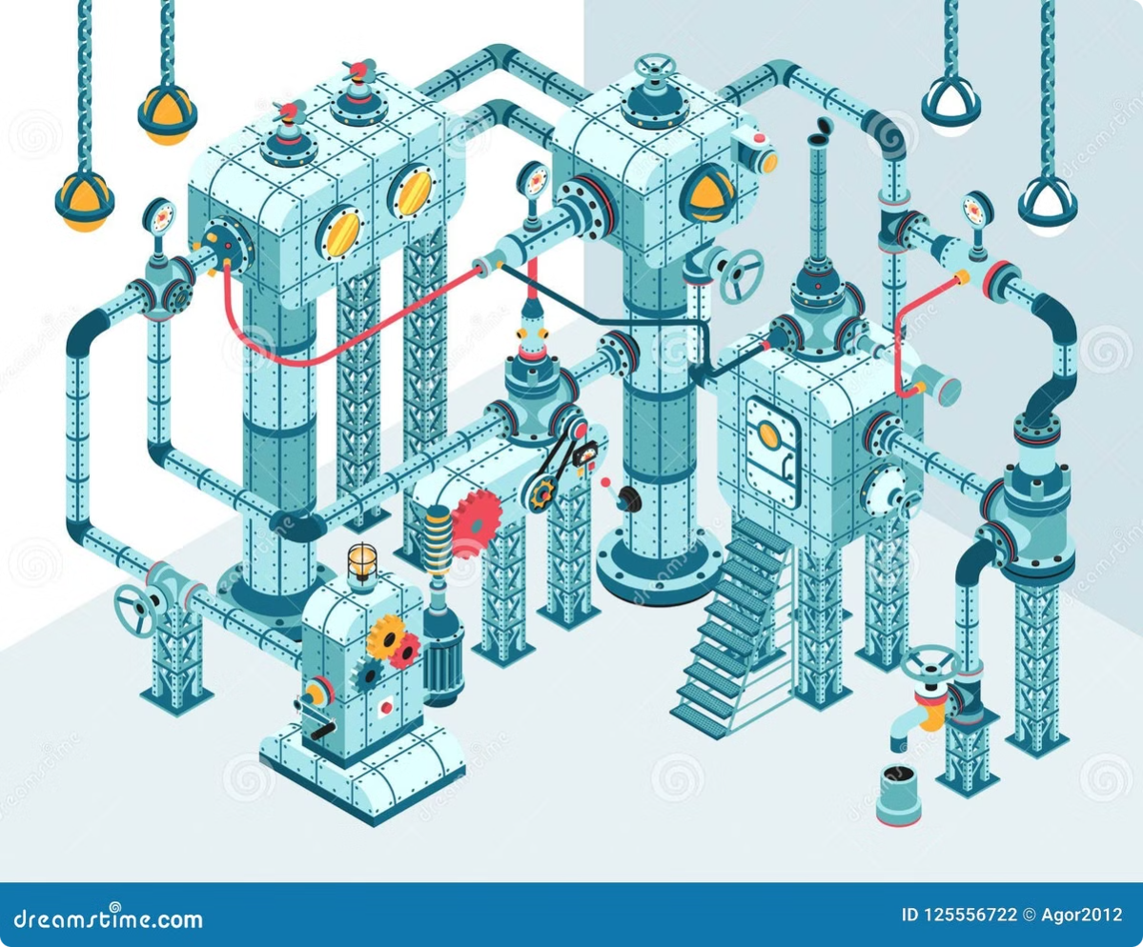
Suppliers
Quality Analysis
This presentation delves into a comprehensive analysis of defected items, focusing on identifying key defect trends, root causes, and actionable insights to improve product quality. By examining data from various sources, including defect records, manufacturing information, and vendor details, we aim to understand the drivers of defects and recommend strategies to mitigate their occurrence.

Slide 2
Team Onboarding
Kamal Ashour ‘Lead’
Ahmed Hani
Omar Farid
Reham fathy

Slide 3
Introduction
The purpose of this analysis is to provide a comprehensive understanding of the defected items within our manufacturing processes. Through meticulous data exploration, we will identify key defect categories, defect types, and patterns over time. This analysis aims to pinpoint areas for improvement and inform strategic decisions to enhance overall product quality.
1
Objective 1
2
Objective 2
Explore defect categories, identifying the most prevalent defect types within our production processes.
Analyze defect trends over time, highlighting any seasonal variations or emerging patterns in defect occurrences.
3
Objective 3
4
Objective 4
Identify key contributing factors to defects, such as vendor performance, material inconsistencies, or manufacturing process issues.
Develop actionable insights and recommendations to address the root causes of defects, leading to improvements in quality control and overall product quality.

Slide 4
Data Source and Structure
The foundation of our analysis is a comprehensive dataset drawn from various sources within our manufacturing system. This dataset encompasses information about defected items, along with related details about their categories, types, locations, vendors, and production dates.
Table
Description
fDefected\_Items
Main fact table containing information about defected items, including defect date, category, type, location, vendor, and material type.
dCalendr
Dimension table providing date information, including month, year, and quarter.
dCategory
Dimension table listing the various defect categories (e.g., cosmetic, functional, performance).
dDefect\_Type
Dimension table specifying the different types of defects within each category.
dVendor
Dimension table containing details about the vendors supplying materials or components.
dPlants
Dimension table listing the different manufacturing locations or plants where the defects occur.
dMaterial\_Type
Dimension table listing the different materials used in production.

Slide 5
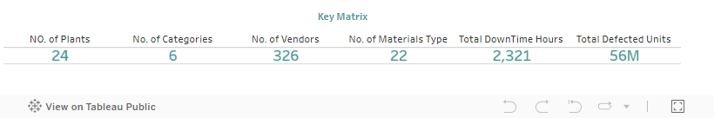
Key Metrics
To gain initial insights, we've identified key metrics that provide a snapshot of the overall defect landscape. These metrics help us understand the frequency, distribution, and potential areas for improvement in our quality control processes.
Defect Count
Defect Category Distribution
Plants with Highest Defect Rates
The total number of defected items recorded during the analysis period. This provides a baseline understanding of the overall defect rate.
The percentage of defects belonging to different categories (e.g., cosmetic, functional, performance), illustrating the most prevalent defect types.
Ranking of plants based on the number of defected items, highlighting locations with significant defect occurrences that require targeted attention.

Slide 6
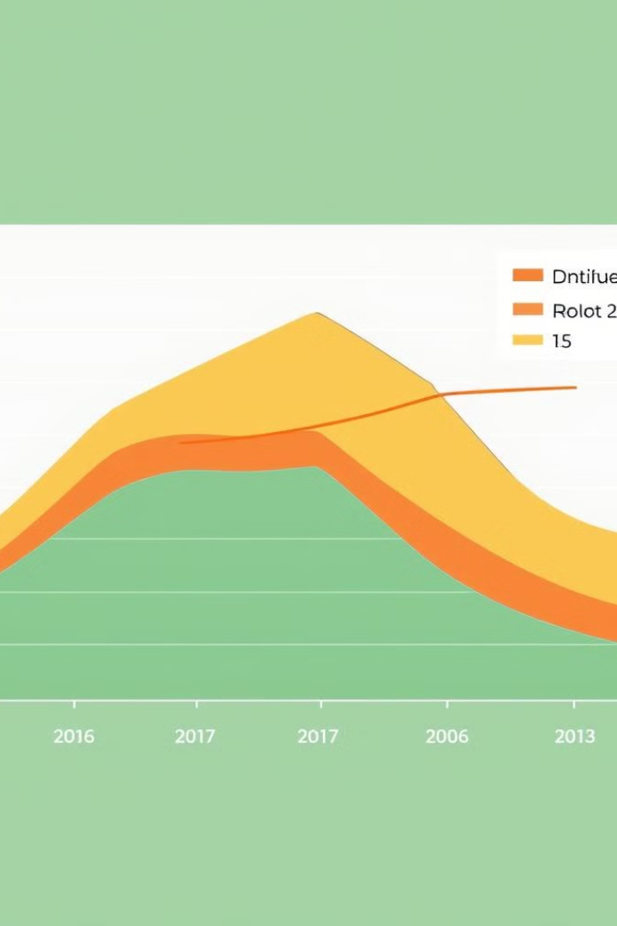
Trend Analysis
To identify patterns and potential seasonal variations in defect occurrences, we conducted a time-based analysis of defected items. This analysis provides a clear picture of how defect rates evolve over time and allows us to pinpoint potential root causes associated with specific periods.
1
Month-on-Month Trend
A visual representation of the change in defect counts from month to month, revealing any fluctuations or patterns in defect occurrences.
2
Year-on-Year Trend
Comparison of defect counts from year to year, highlighting any significant increases or decreases in defect rates and revealing broader trends.
3
Seasonal Trends
Analysis of any recurring patterns in defect counts during specific seasons or months, revealing potential environmental or operational factors impacting defect rates.

Slide 7
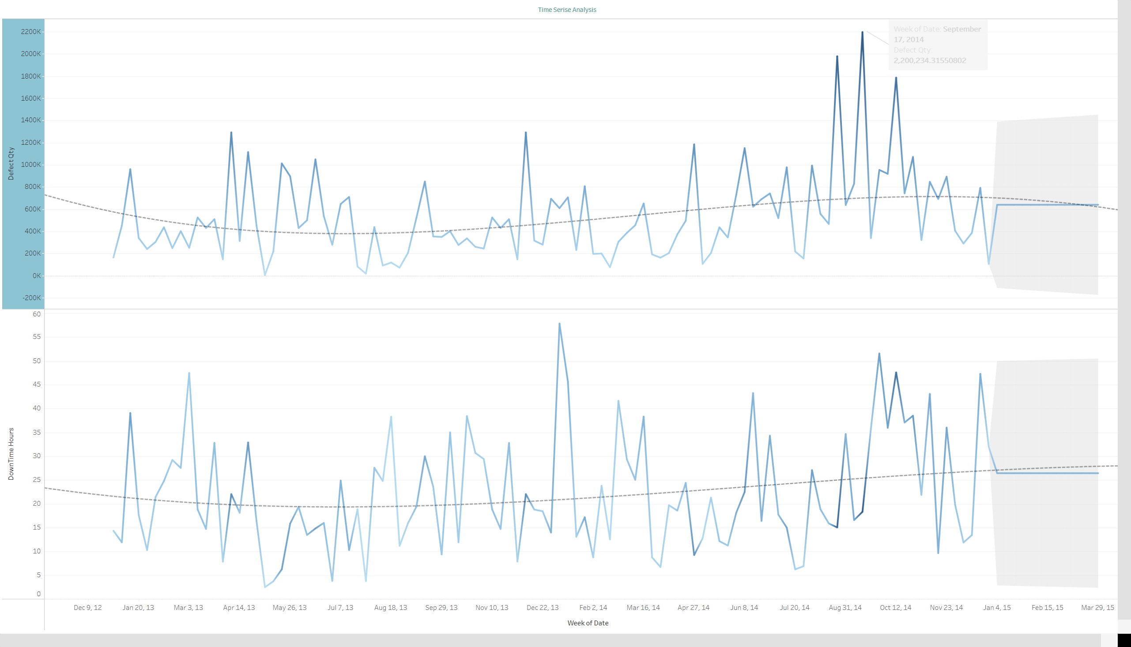

Slide 8
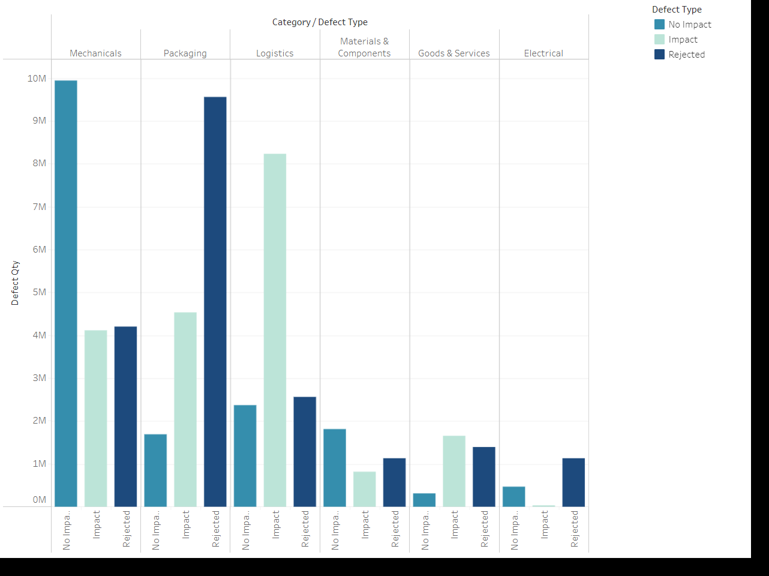
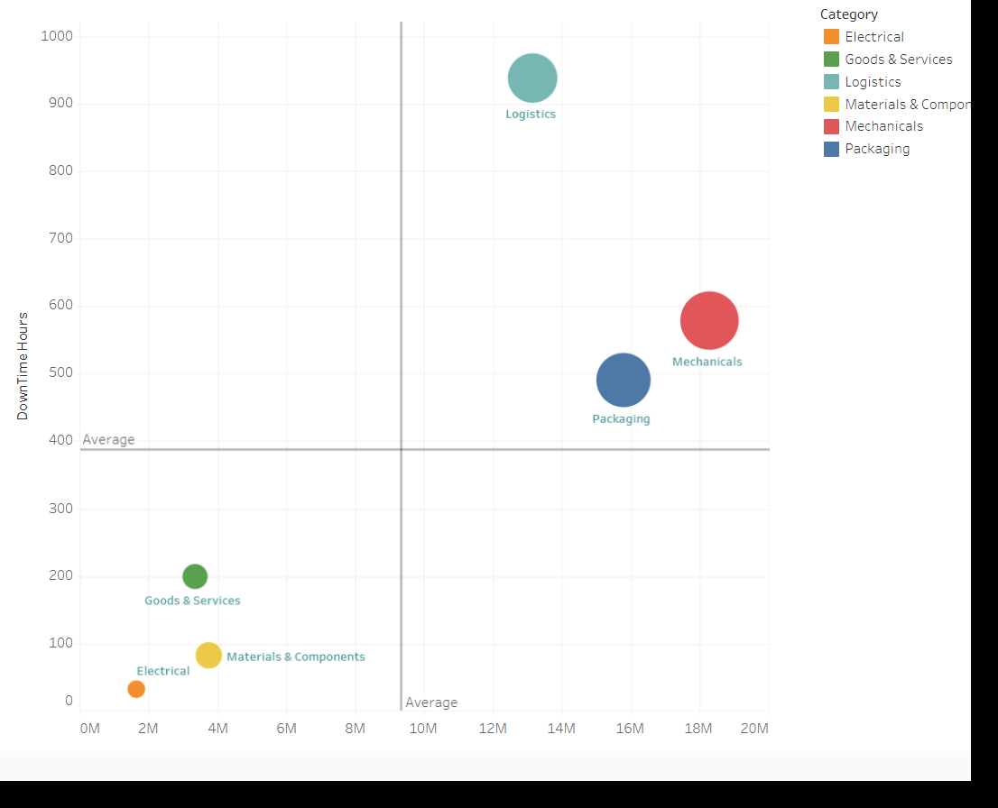
Defect Categories and Types
A deeper dive into the nature of defects reveals a distribution of various categories and types. Analyzing these categories and types provides a more granular understanding of the specific issues impacting product quality.
Defect Category Distribution
Defect Type Breakdown
A visual representation of the percentage of defects belonging to each category, revealing the most prevalent defect types within our production processes.
A detailed breakdown of the different types of defects within each category, providing a more granular understanding of the specific issues contributing to product quality issues.

Slide 9




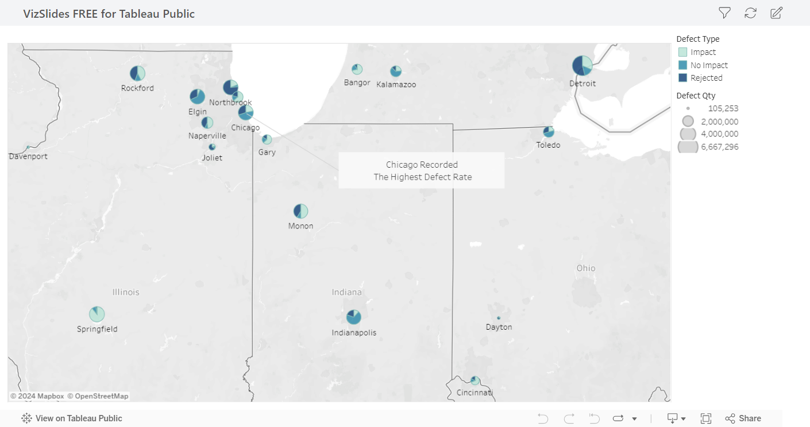
Geographical
Analysis
Focused Investigation
Heatmap Visualization
Targeted investigations into specific locations with high defect rates, allowing for focused analysis and potential root cause identification.
Analyzing defects across different geographical locations can reveal spatial patterns or regional variations in defect occurrences. This information helps us understand potential environmental or plant-specific factors impacting product quality.
Plant-Specific Trends
A visually compelling heatmap showing the density of defects across different locations, enabling quick identification of areas with high defect concentration.
A breakdown of defect counts by plant, revealing any geographical clusters or regional variations in defect rates.

Slide 10
Vendor and Material Analysis
Analyzing defect data in relation to vendors and material types can reveal crucial insights into the source of product quality issues. This information helps us identify potential supplier-related problems or material inconsistencies impacting our production processes.
Vendor Contribution
Material Type Analysis
A breakdown of defect counts by vendor, highlighting suppliers whose materials or components are frequently associated with defects.
An analysis of defect occurrences related to different material types, revealing potential material-specific issues impacting product quality.

Slide 11


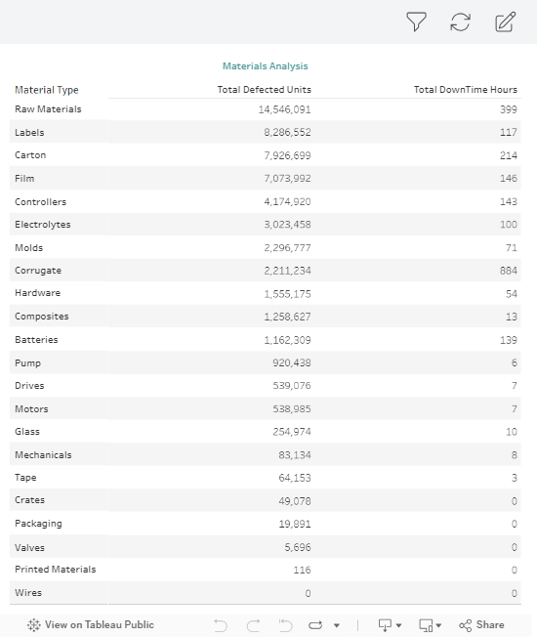
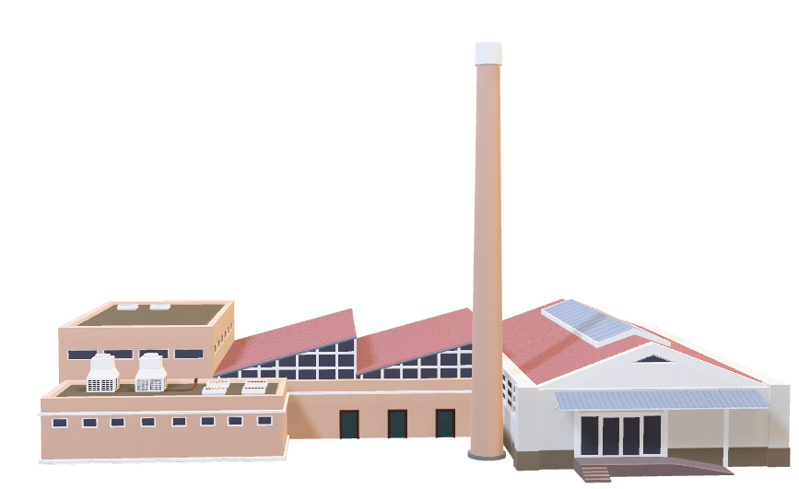
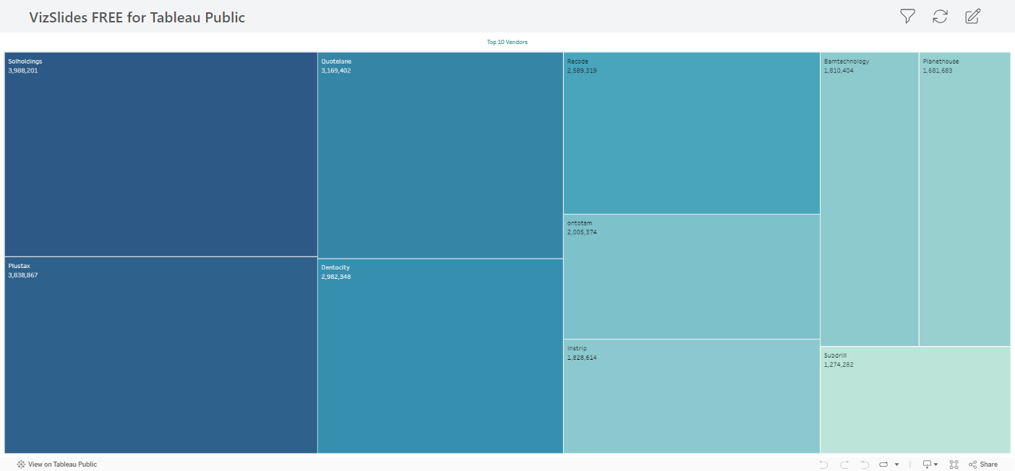
Vendor and Material Analysis

Slide 12
Key Insights and Findings
Our analysis has uncovered key insights and trends related to defected items. These findings provide a foundation for developing actionable strategies to improve product quality and minimize defect occurrences.
1
Insight 1
2
Insight 2
The analysis highlights a significant correlation between vendor performance and defect rates, suggesting that certain suppliers consistently contribute to a higher proportion of defects.
The time-based analysis reveals a seasonal trend in defect occurrences, indicating potential environmental or operational factors impacting product quality during specific periods.
3
Insight 3
4
Insight 4
Geographical analysis identifies a particular plant with consistently higher defect rates, indicating potential plant-specific issues requiring further investigation and corrective measures.
The breakdown of defect categories and types reveals that a specific category of defects, such as functional defects, consistently contributes to a significant portion of overall product quality issues.

Slide 13
Conclusion and Recommendations
Based on our analysis, we recommend the following actions to mitigate defects, improve product quality, and enhance overall manufacturing efficiency.
Recommendation 1
Recommendation 2
Conduct a thorough evaluation of vendors associated with higher defect rates, potentially leading to revised supplier agreements or sourcing alternatives to minimize future defect occurrences.
Implement targeted quality control measures during periods of high defect occurrence, potentially involving increased inspection frequency or process adjustments to address the identified seasonal trends.
Recommendation 3
Recommendation 4
Conduct a comprehensive root cause analysis at the plant with consistently higher defect rates, identifying potential plant-specific factors or process variations contributing to defect occurrences.
Invest in training and process improvements related to the specific defect category identified as contributing to a significant portion of quality issues, addressing the root cause and improving overall quality control.

